Slide 1
Support Vector Machines – Part 2
UIUC ECON 490: Applied Machine Learning in Economics

Slide 2
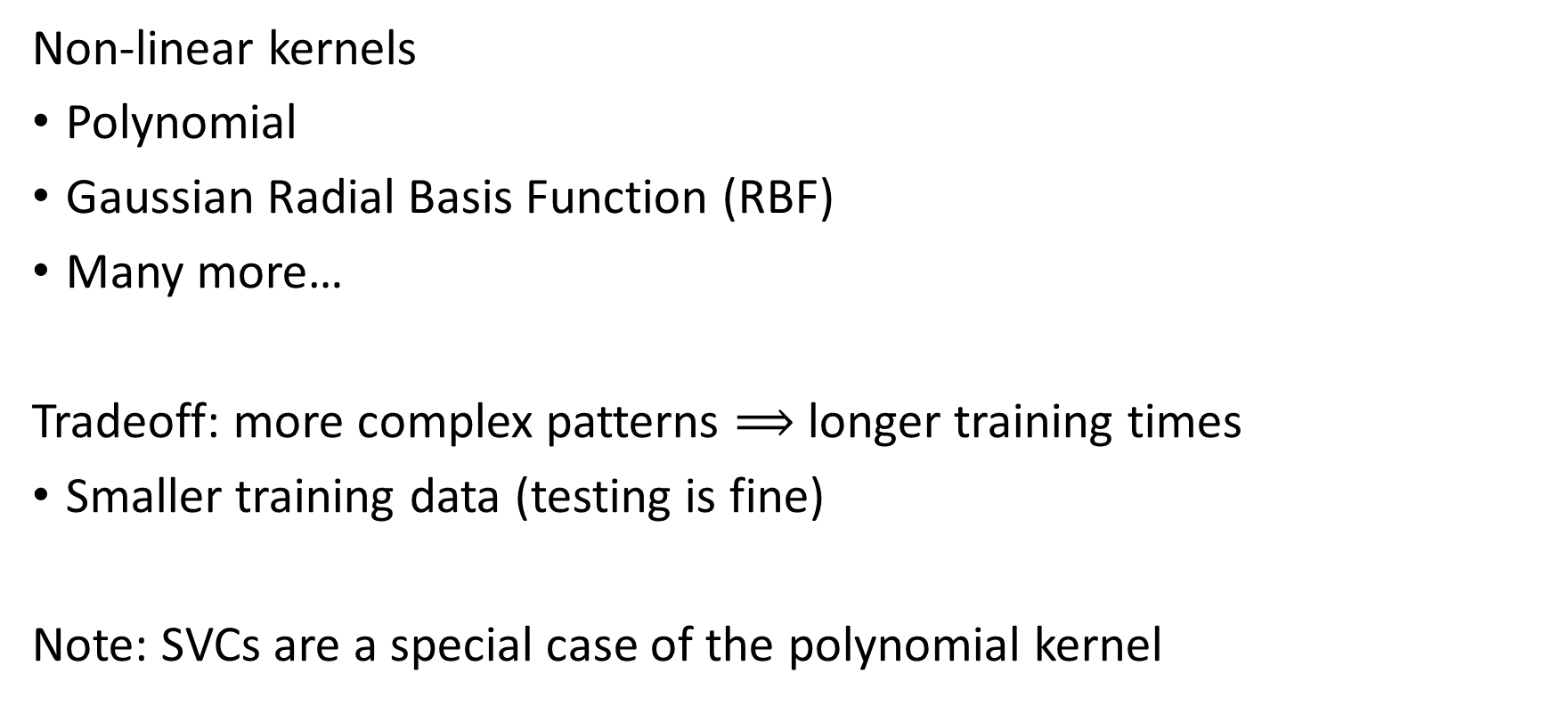
The “M” in SVM
Non-linear kernels
Polynomial
Gaussian Radial Basis Function (RBF)
Many more…
Tradeoff: more complex patterns $⟹$ longer training times
Smaller training data (testing is fine)
Note: SVCs are a special case of the polynomial kernel

Slide 3
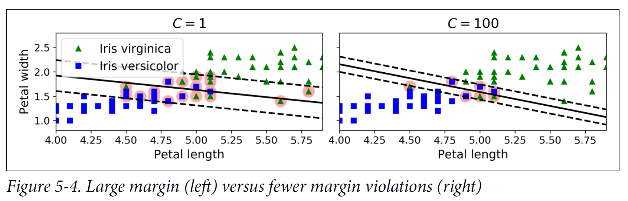
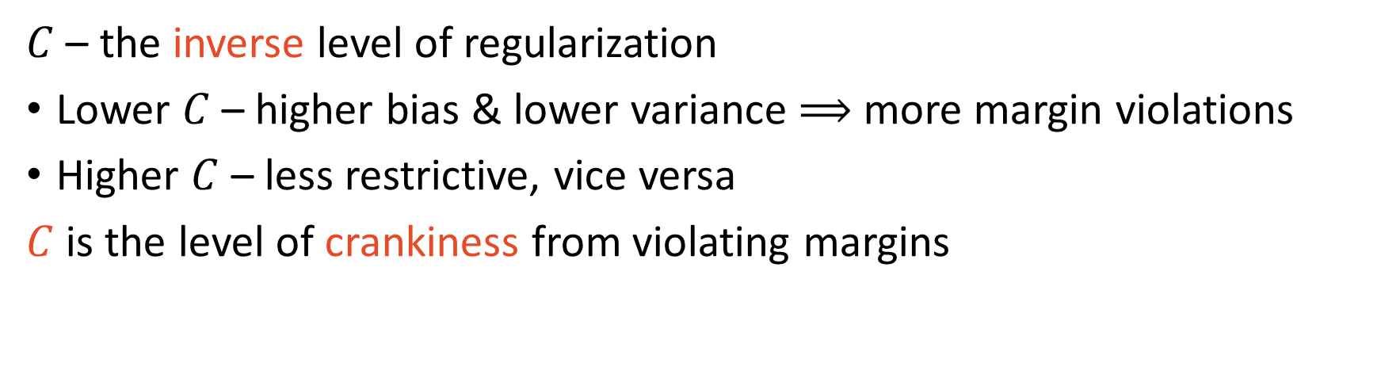
Refresher: $C$ controls margin violations
$C$ – the inverse level of regularization
Lower $C$ – higher bias & lower variance $⟹$ more margin violations
Higher $C$ – less restrictive, vice versa
$C$is the level of crankiness from violating margins

Slide 4
Polynomial Kernels
Wiggly widest street

Slide 5
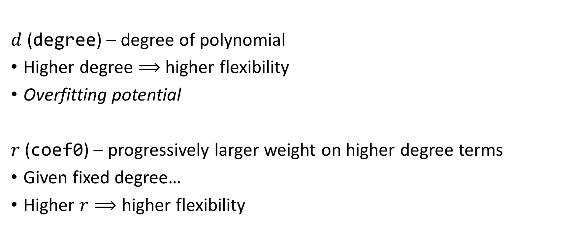
Poly – Hyperparameters
$d$ (degree) – degree of polynomial
Higher degree $⟹$ higher flexibility
Overfitting potential
$r$ (coef0) – progressively larger weight on higher degree terms
Given fixed degree…
Higher $r⟹$ higher flexibility

Slide 6
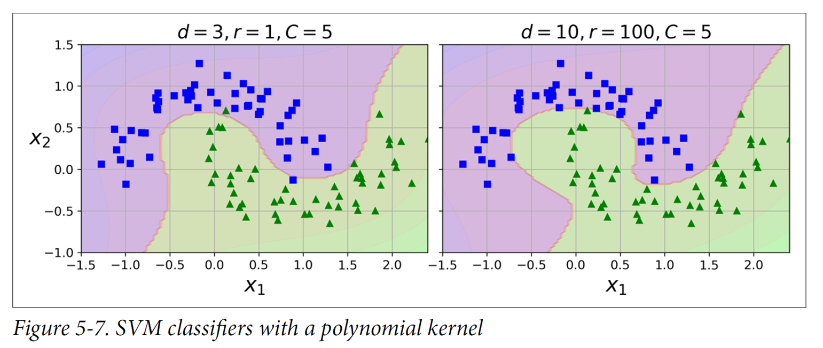
Higher $r$ and $d⟹$ higher flexibility

Slide 7
Gaussian Radial Basis Functions
Hidden bell curves

Slide 8

RBF – Hyperparameters
$γ$ – as $γ↑$, bell curve narrows
Acts as regularization like $C$
If overfitting, reduce

Slide 9
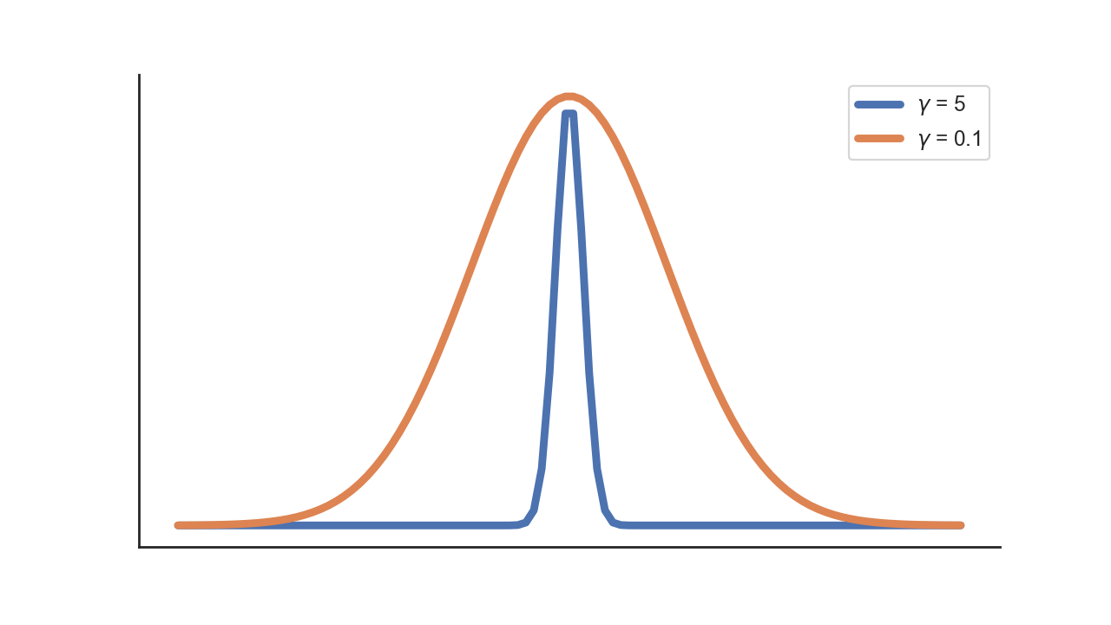
Question: which is more flexible?

Slide 10


Answer
Larger $γ$
Specifies smaller region

Slide 11
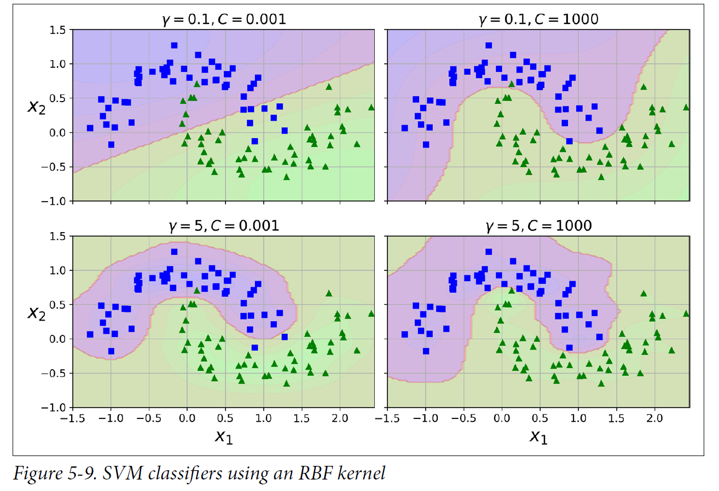
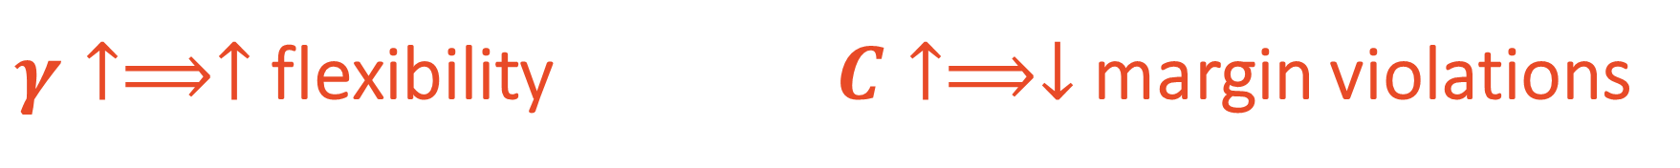
$γ↑⟹↑$ flexibility $C↑⟹↓$ margin violations
Computationally challenging to find optimum $⟹$ slow training

Slide 12
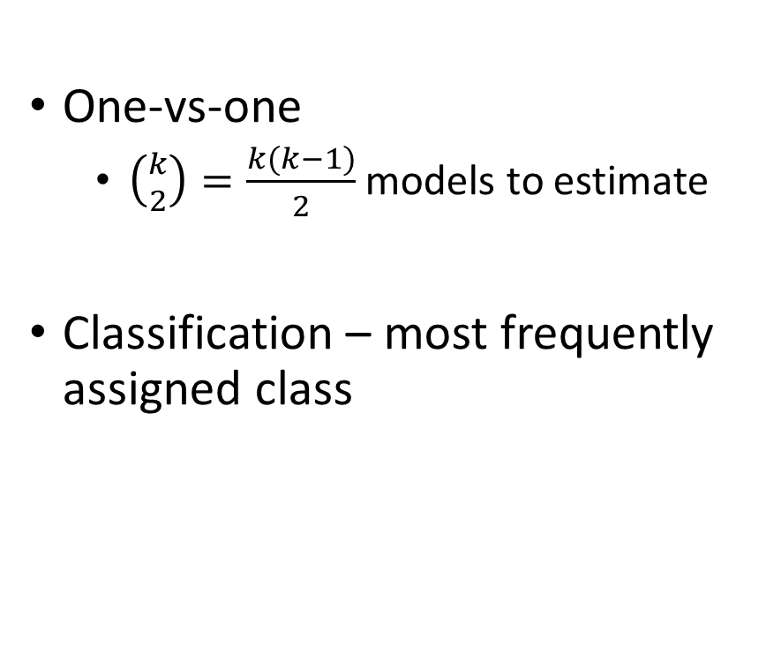
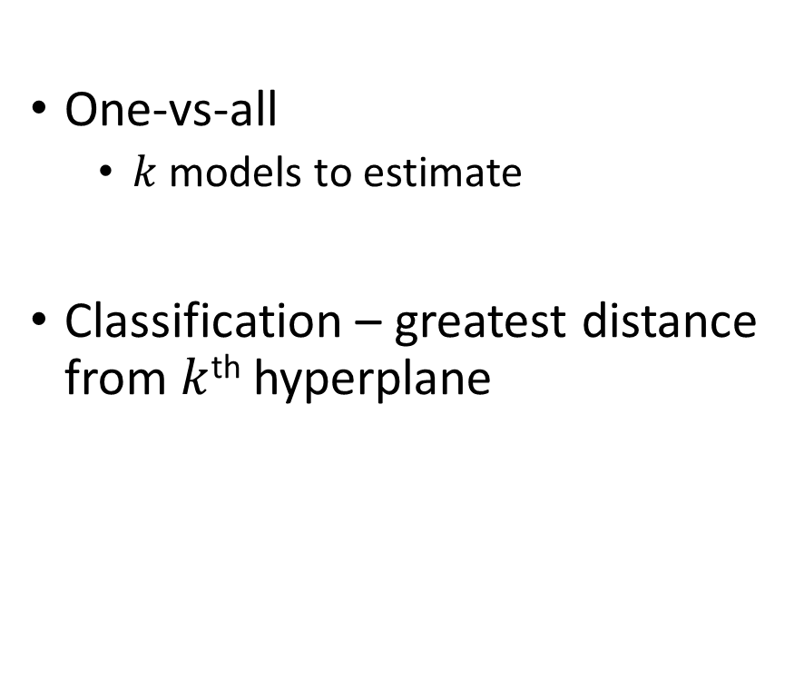
Multiple Classes ($k$)
One-vs-one
$\left({k \atop 2}\right)$ $=\frac{k(k−1)}{2}$ models to estimate
Classification – most frequently assigned class
One-vs-all
$k$ models to estimate
Classification – greatest distance from $k$^{th} hyperplane

Slide 13
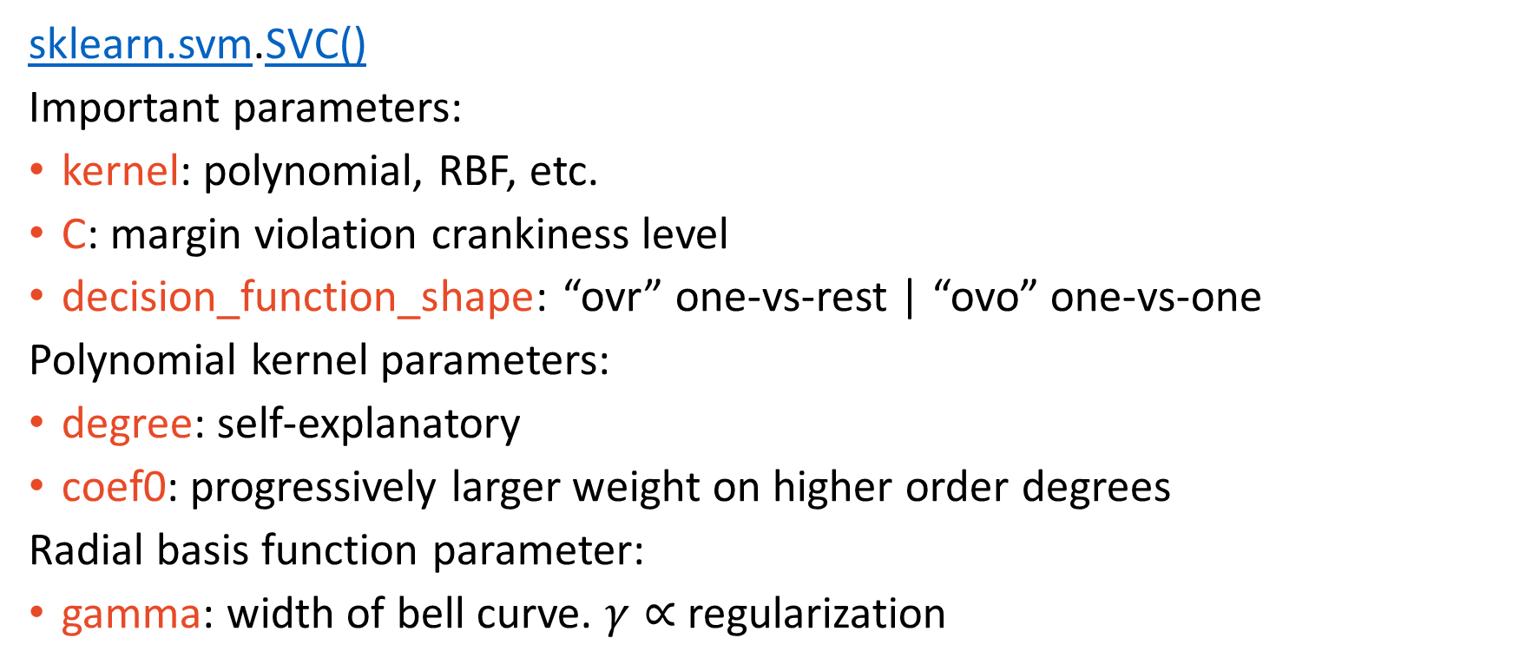
Implementation – Scikit-learn
sklearn.svm.SVC()
Important parameters:
kernel: polynomial, RBF, etc.
C: margin violation crankiness level
decision_function_shape: “ovr” one-vs-rest | “ovo” one-vs-one
Polynomial kernel parameters:
degree: self-explanatory
coef0: progressively larger weight on higher order degrees
Radial basis function parameter:
gamma: width of bell curve. $γ∝$ regularization

Slide 14
SVM Regression
Get on the street!

Slide 15
SVM Regression
Classification – fit the widest street between the data
Regression – opposite idea:
fit the widest street along the data
All kernels apply!

Slide 16
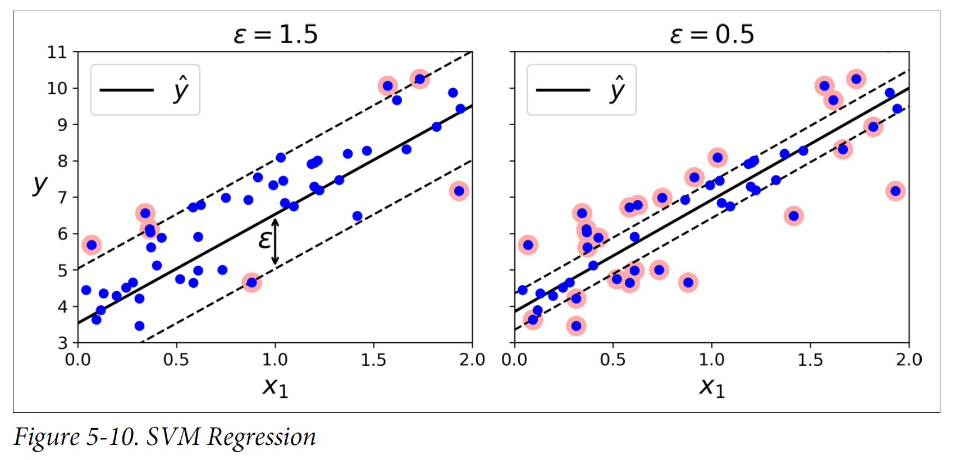
SVMR New Hyperparameter: $ε$ – width of the street

Slide 17
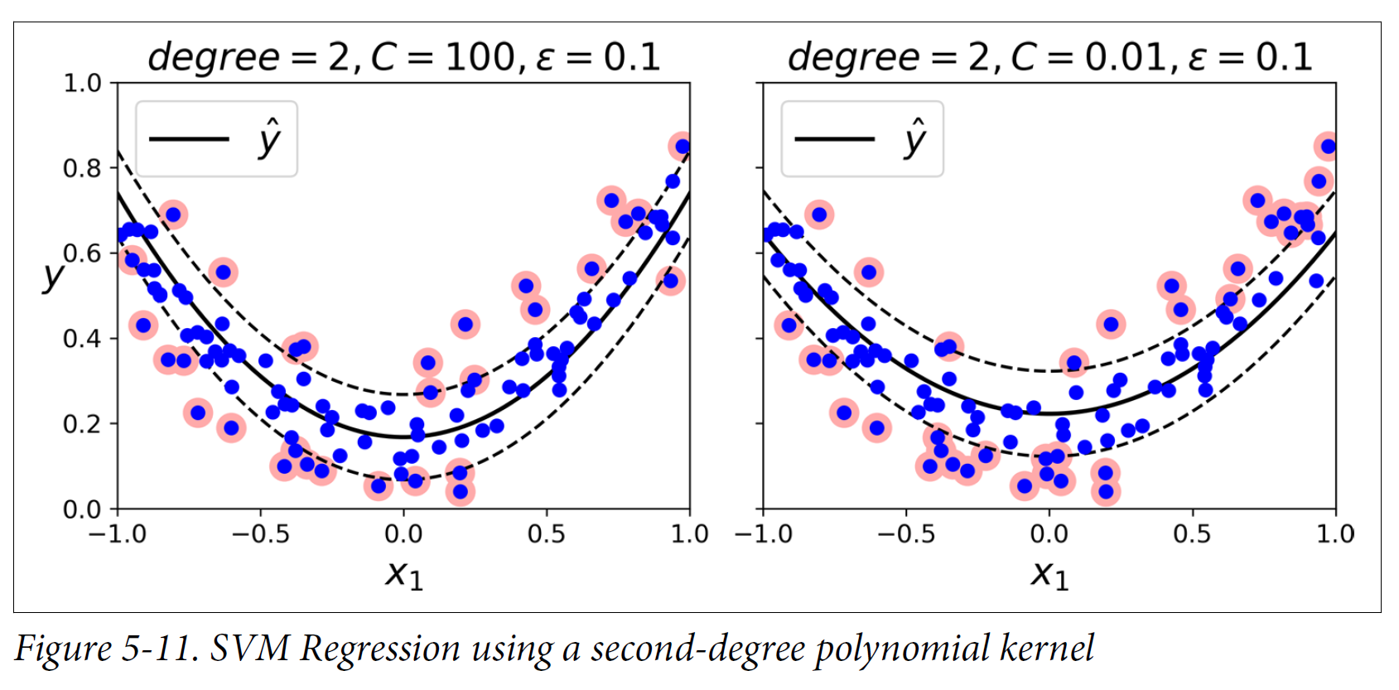
SVMR – constant $ε$ (30 vs 36 violations)

Slide 18
Implementation – Scikit-learn
sklearn.svm.LinearSVR()
Important parameters
C: margin violation crankiness level
epsilon: width of the street
dual: Set “False” if # obs > # features (our case)
LinearSVR/C computationally optimized for linear kernels!
sklearn.svm.SVR()
Important parameters
C, epsilon
Polynomial kernel parameters:
degree, coef0:
Radial basis function parameter:
gamma

Slide 19
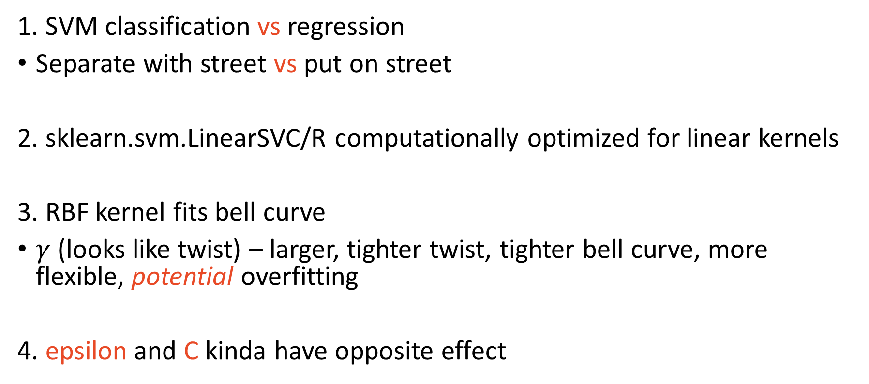
Main Takeaways
1. SVM classification vs regression
Separate with street vs put on street
2. sklearn.svm.LinearSVC/R computationally optimized for linear kernels
3. RBF kernel fits bell curve
$γ$ (looks like twist) – larger, tighter twist, tighter bell curve, more flexible, potential overfitting
4. epsilon and C kinda have opposite effect

